Slide 1
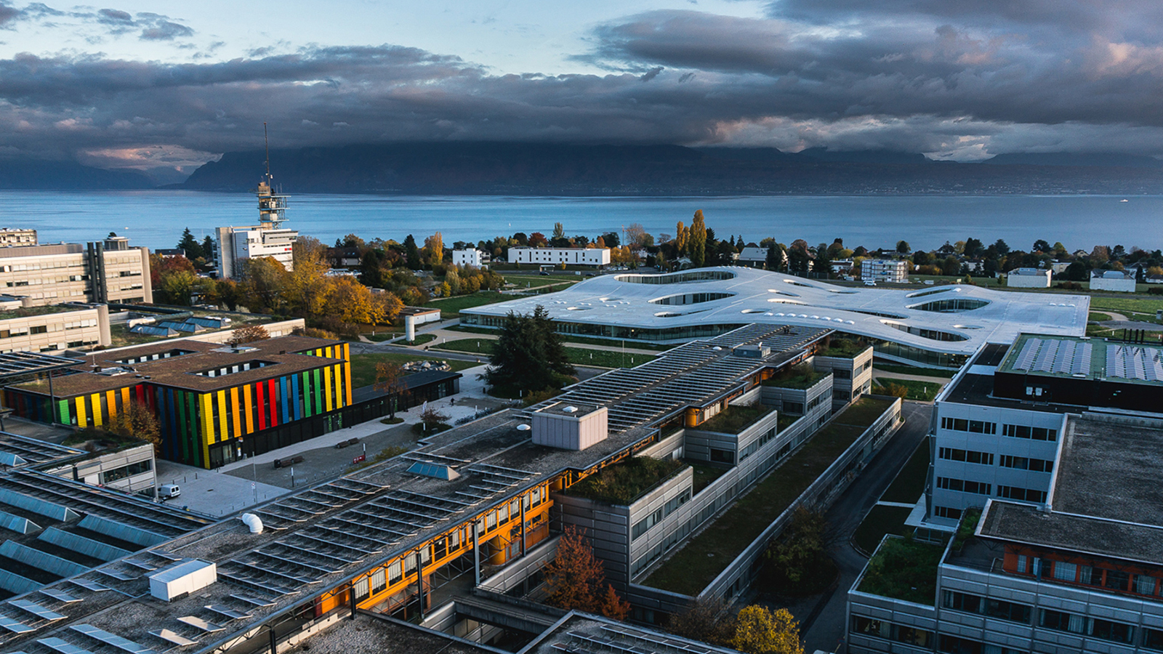

Deep Learning on 3D meshes via Model Simplification Semester Project Presentation
June 4th, 2018
Presenter : Cleres David, CSE – Master 2
Supervisor: Prof. Pascal Fua
École Polytechnique Fédérale de Lausanne – EPFL
CVLAB
Notes:
Se présenter = David Cleres, doing my master in Computational Science & Engineering (CSE)

Slide 2
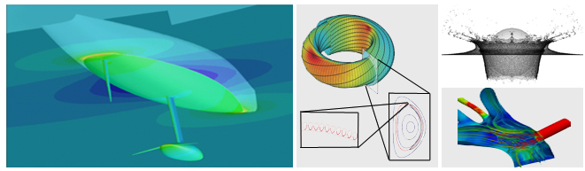
Computational Science & Engineering (CSE)
CSE Semester Project = 8 ECTS (during the semester)
Rules
The project takes between 1 and 1.5 days / week.
Weekly supervision through meetings with the PhD/ Post-Doc Student
Report at the end of the project
Oral presentation
Source: EPFL website
Notes:
About the lab

Slide 3
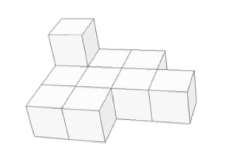
What is a Polycube?
A poly-cube is a 3d shape composed of axis aligned unit cubes that are attached face to face
Applications
Bla
La
La
Source: [Tarini et al. 2004]
Notes:
- Why is it useful?
Donner les differents domaines d’application pour avoir un peu une idée de ce qu’on peut faire avec les cubes

Slide 4
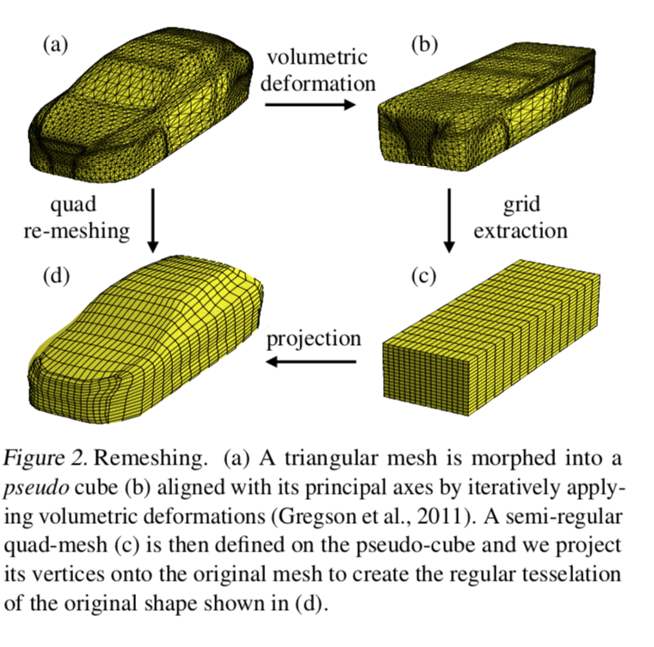
Basics in Polycube Mapping
Source: Baqué, P., Remelli, E., Fleuret, F., & Fua, P. (2018). Geodesic Convolutional Shape Optimization. Retrieved from http://arxiv.org/abs/1802.04016
Notes:
Aerodynamic shape optimization plays a major role in many applications to aircraft, cars, trains, turbines, internal pipe flows, and cavities, among others. With the ever increasing computational power during the passed 60 years, automated design optimzation procedures and Computational Flow Simulation (CFD) have become more competent. However, the state-of-the art methods used in industry are so computationally demanding that typical engineering practices are to either simply try a limited umber of hand-designed shapes or restrict oneself to shapes that can be parameterized using only few degrees of freedom. The use of artificial neural networks (ANN) in order to emulate a fluidynamics simulator by training Geodesic Convolutional Neural Networks outperforms the industrial methods by 5 to 20\% for standard problems and, even more importantly and applies to cases that previous methods cannot handle. However, the generation of Polycubic structures still require important amount of resources, an issue tackled in this document by using Deep Learning to learn how to generate these simplified structures starting from a standard STL file.
The goal of this project is to explore how polycube model simplification can be utilized to perform deep learning on 3D meshes efficiently: in particular the aim is to implement a polycube mapping algorithm and create a dataset of simplified models with it. Once such data-set is created 3D CNNs can be exploited to obtain efficient solid model simplification.
This report starts with a description of the dataset. Then, the basic principles of CNN will be presented and the computational time needed to generate an accuracy polycube structure using a CNN will be compared to the time needed by the algorithm that was generated to create the ground-truth answers of the initial training set. Section IV will be dedicated to present the results of the different neural net architectures and regressions that were used to perform a reliable prediction. Finally, discussion and auto-critic on the results will be made in this final part of the report.

Slide 5


Can we do this more efficiently?
3 Different languages
Algorithmic complexity of the cubing process
…
Notes:
-

Slide 6



Project Timeline
Reading papers about voxelization techniques, shape simplification, polycubes, computer vision, …
Automatic Polycube Generation for car shapes = Generation of the dataset for step 5
Step 2
Step 4
Step 1
Step 3
Step 5
Set-up meetings with Edoardo
Getting started on meshes
Training a deep neural network to learn the cubification
Implementation of the solid voxelization

Slide 7
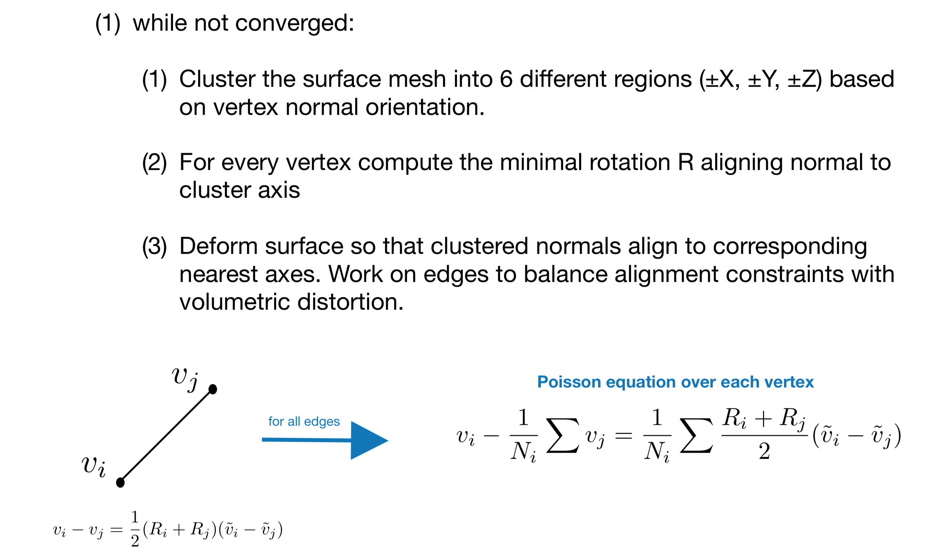
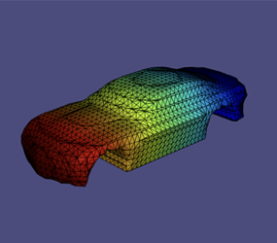
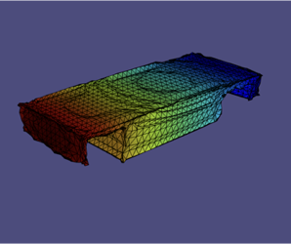
Axis Aligning Deformation
Iteratively deform a geometric model into a geometrically regular axis aligned shape
Algorithm
Results
Notes:
About the lab

Slide 8
Volumetric Voxelization
Voxelize the axis aligned model by sampling the model’s signed distance function on a regular grid defined over the model’s bounding box
Notes:
About the lab

Slide 9
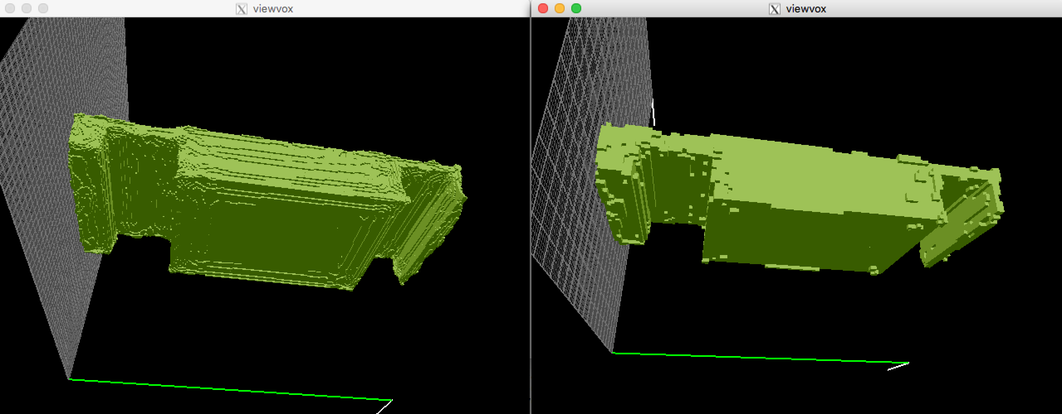
Example – Grid Size
Grid Size = 256
Grid Size = 100
Notes:
One could play on the precision of the voxelization by tacking different grid sizes

Slide 10
Hough Transform
Create the accumulator space, which is made up of a cell for each voxel, and set each cell to zero
Local Voting: for each boundary voxel (i,j,k) increment by 1 all cells that belong to the axis aligned planes centered in voxel (i,j,k) and to the neighborhood of the voxel
Search for local maxima in the accumulator space, these voxels represent the corners in the binary volume detected by the algorithm
Find polycubes in the domain by finding matching corners
Notes:
Find the Corners in the 3D Structure
Trouver encore des papers qui en parle mais aussi des explications

Slide 11
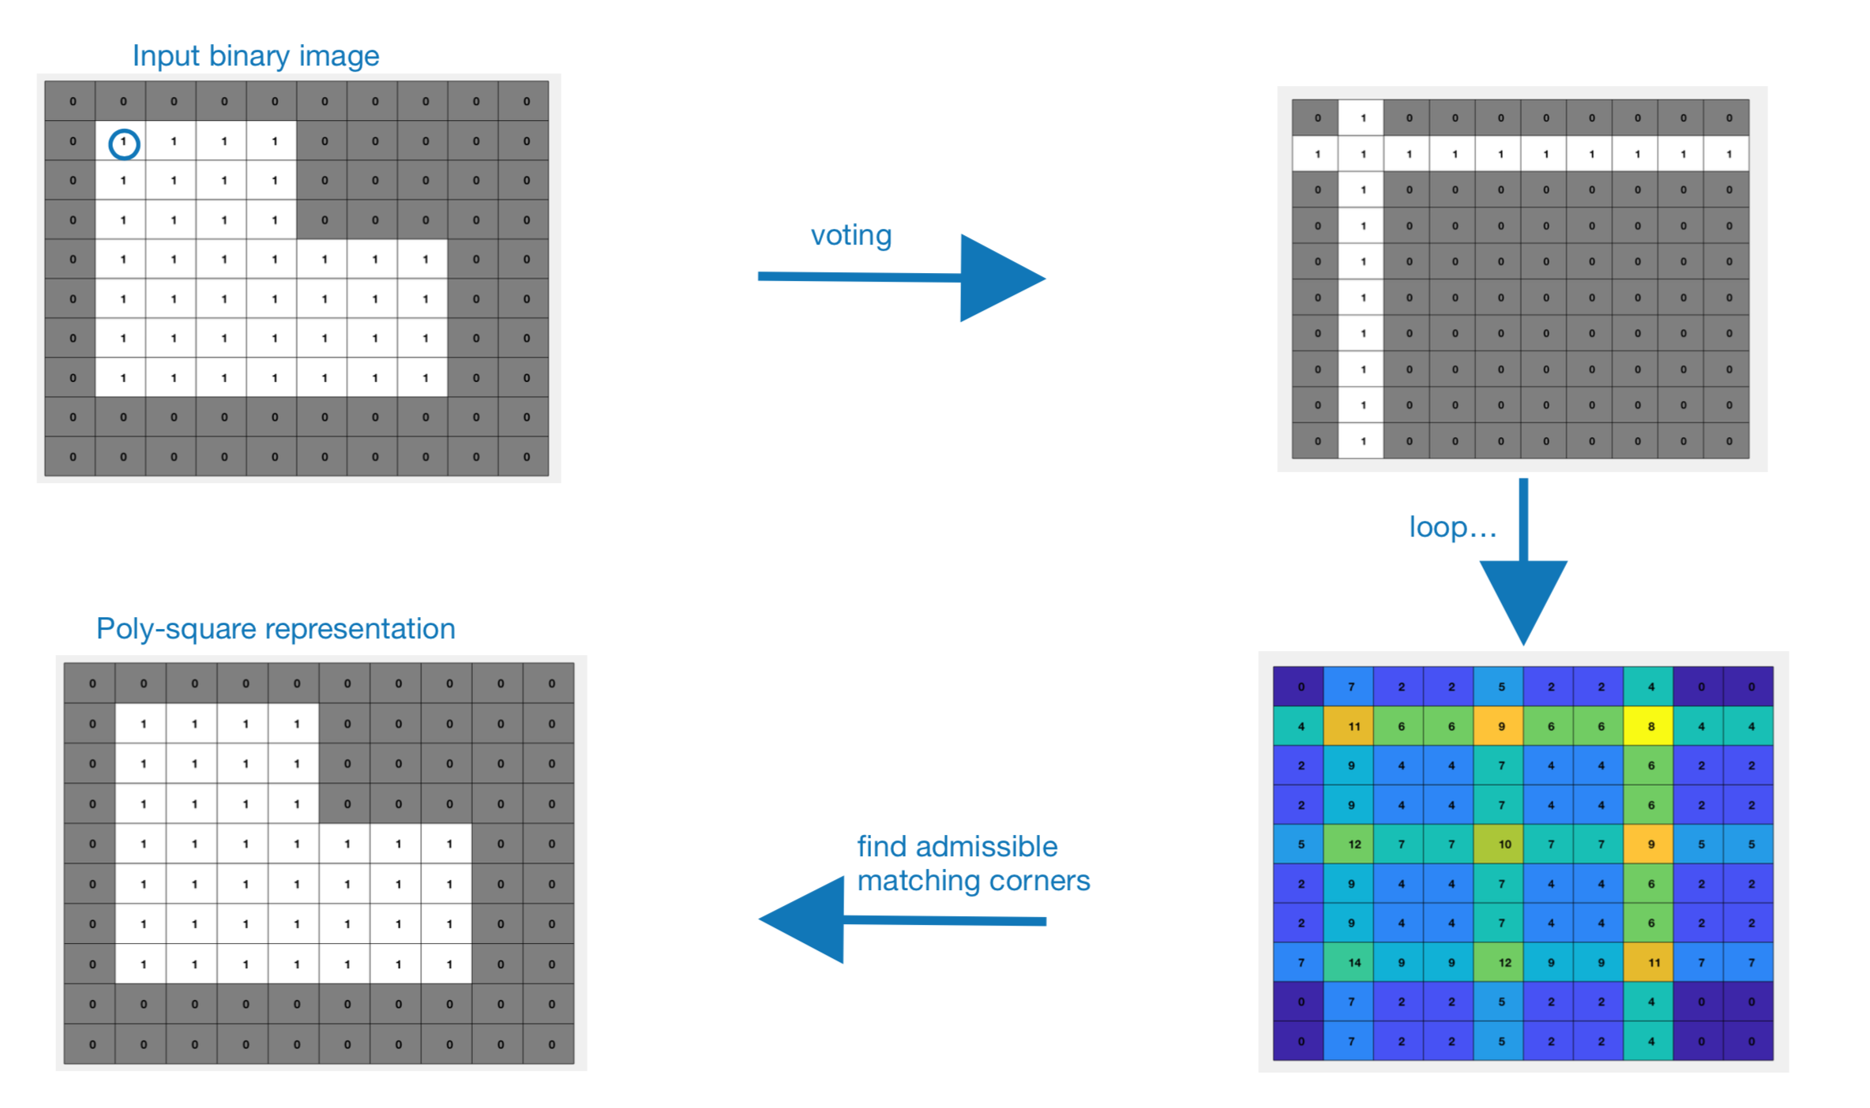
Zoom on Voting

Slide 12
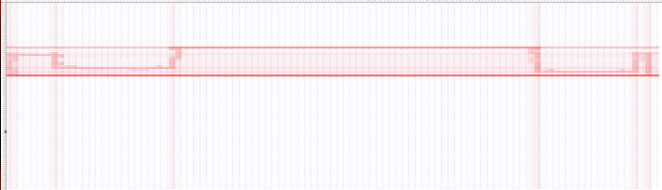
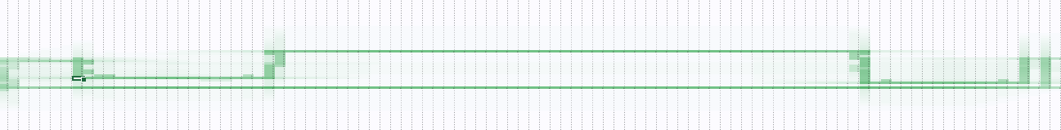
Voting – Applied to the car Problem
Voting
Local Voting
vs.

Slide 13
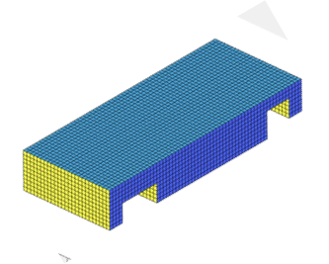
Results
Voxelization???
Mesh
Axis Aligned Mesh
Voxelized Axis Aligned Mesh
Polycube
Ajouter une voiture du data set pour faire la transition

Slide 14

Where is the deep Learning?

Slide 15
The Dataset
Raw Dataset: collection of 1221 stereolithography (STL) files containing discretized shapes of cars
Processed using the C++ pipeline to generate cubes
(Poly)cube structures were then used as the ground-truth of the training set
Voxelized meshes were used as input for the artificial neural network
Notes:
The raw dataset consisted of a collection of 1221 stereolithography (STL) files containing the discretized shapes of cars. These data was processed using the C++ pipeline that will be explained in the \textit{method} section. By using this program, one was able to generate a Polycube structure starting from the given STL files (Fig. \ref{fig:fig1} \& \ref{fig:fig2}). These Polycube structures were then used as the \textit{Ground-truth representation (GT)} files of the training set, whereas the given files were used as input for the artificial neural network that was developed.

Slide 16
Preprocessing & Data Augmentation
Data was split in Training and Validations set

Slide 17
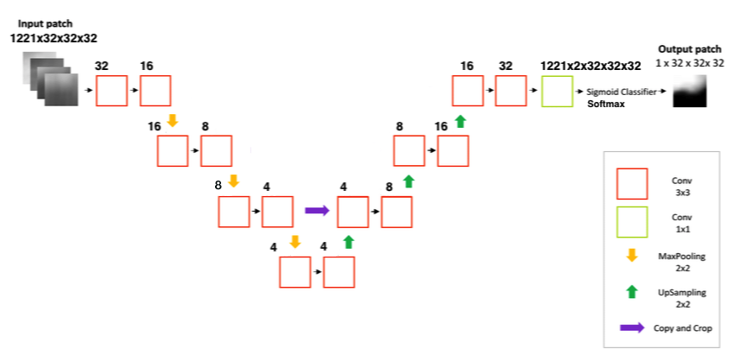
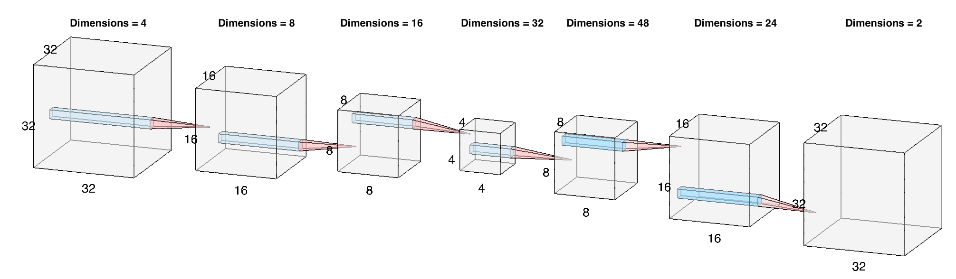
The U-Net

Slide 18
Results - LeakyReLu Activation function

Slide 19
Results – LeakyReLu Activation function – Light Model

Slide 20
Results – ReLu Activation function – Light Model

Slide 21
Results – Sigmoid Activation function – Light Model

Slide 22
The CNN

Slide 23
Unet vs. CNN

Slide 24
Results
Time Gain: Comparison avec le script matlab de EDO , C++, Neural Netwrok
Simplicite Algorithmique

Slide 25
References
Baqué, P., Remelli, E., Fleuret, F., & Fua, P. (2018). Geodesic Convolutional Shape Optimization. Retrieved from http://arxiv.org/abs/1802.04016
Alliez, P. and Cohen-Steiner, D. and Tong, Y. and Desbrun, M. (2007). Voronoi-based variational reconstruction of unoriented point sets. Proceedings of the Fifth Eurographics Symposium on Geometry Processing, 39–48. https://doi.org/10.1145/1281991.1281997
Monti, F., Boscaini, D., Masci, J., Rodolà, E., Svoboda, J., & Bronstein, M. M. (2017). Geometric deep learning on graphs and manifolds using mixture model CNNs. Proceedings - 30th IEEE Conference on Computer Vision and Pattern Recognition, CVPR 2017, 2017–January, 5425–5434. https://doi.org/10.1109/CVPR.2017.576
Yu, W., Zhang, K., Wan, S., & Li, X. (2014). Optimizing polycube domain construction for hexahedral remeshing. CAD Computer Aided Design, 46(1), 58–68. https://doi.org/10.1016/j.cad.2013.08.018
Bommes, D., Campen, M., Ebke, H.-C., Alliez, P., & Kobbelt, L. (2013). Integer-grid maps for reliable quad meshing. ACM Transactions on Graphics, 32(4), 1. https://doi.org/10.1145/2461912.2462014
Bommes, D., Lévy, B., Pietroni, N., Puppo, E., Silva, C., Tarini, M., & Zorin, D. (2013). Quad-mesh generation and processing: A survey. Computer Graphics Forum, 32(6), 51–76. https://doi.org/10.1111/cgf.12014
Tarini, M. (2004). PolyCube-Maps. ACM Transactions on Graphics, 23(2), 853–860. https://doi.org/10.1145/1015706.1015810
Umetani, N. (2017). Exploring generative 3D shapes using autoencoder networks. SIGGRAPH Asia 2017 Technical Briefs on - SA ’17, 1–4. https://doi.org/10.1145/3145749.3145758

Slide 26

Questions ?

Slide 27


